Slide 1


Unify your data with CDS
Eric Regnier
Architect & Developer | Dynamics 365 & CDS | DXC NZ

Slide 2
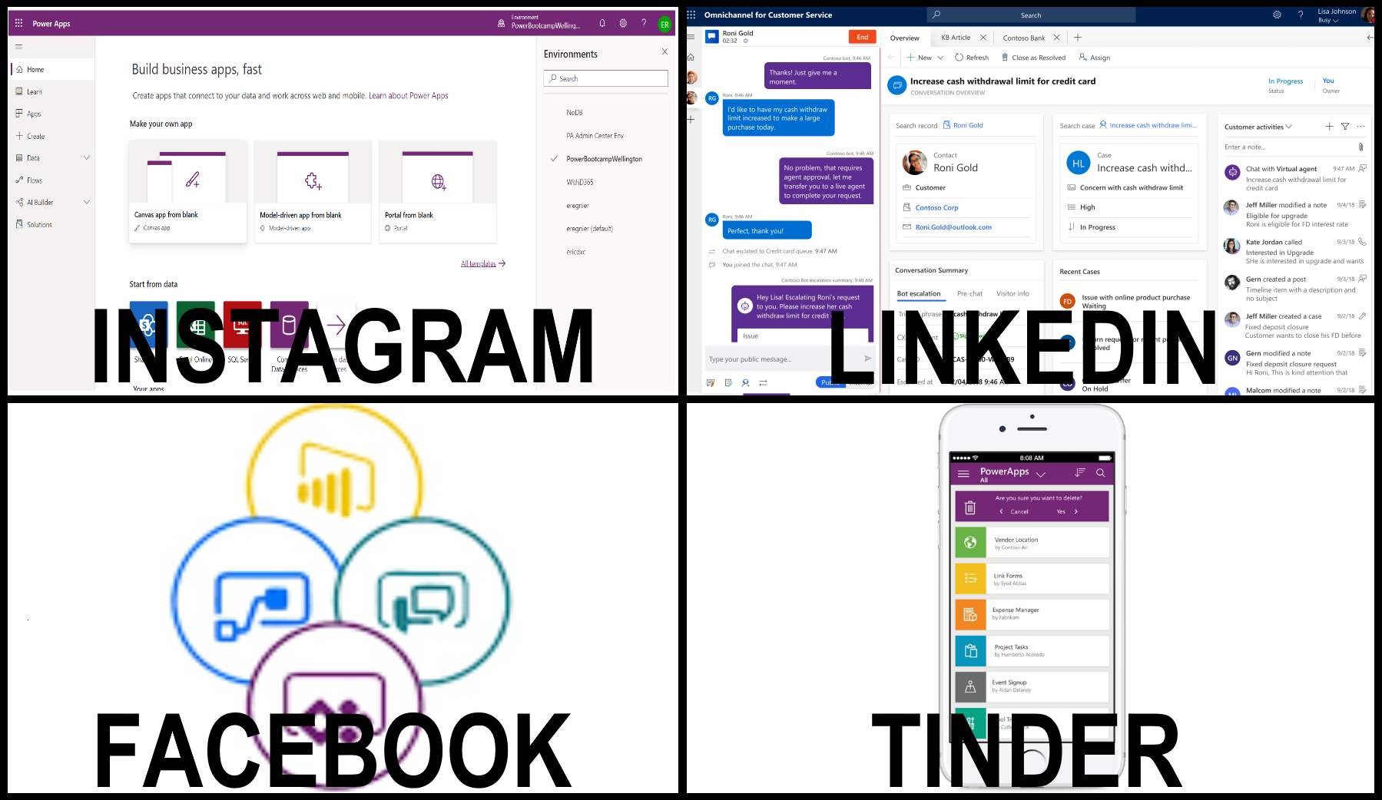
What’s Common Data Service (CDS)?

Slide 3
CDS Capabilities
Activities/Interactions management
Accounts and Contacts management
Data Management (import and export capabilities)
Reporting and dashboards
Users and Queue management
No code business logic client & server side
SDKs and APIs
Auditing and Logging
Searching and querying
SharePoint integration
Currency management
Data Duplication Detection
Multi-language support
Just to name a few…
Centralized and secure data management
Security management
Azure AD integration
Role based access control
Model-driven apps (forms and navigation)
Email management
Exchange integration
Communication templates
Administer and monitor
DevOps Tooling

Slide 4
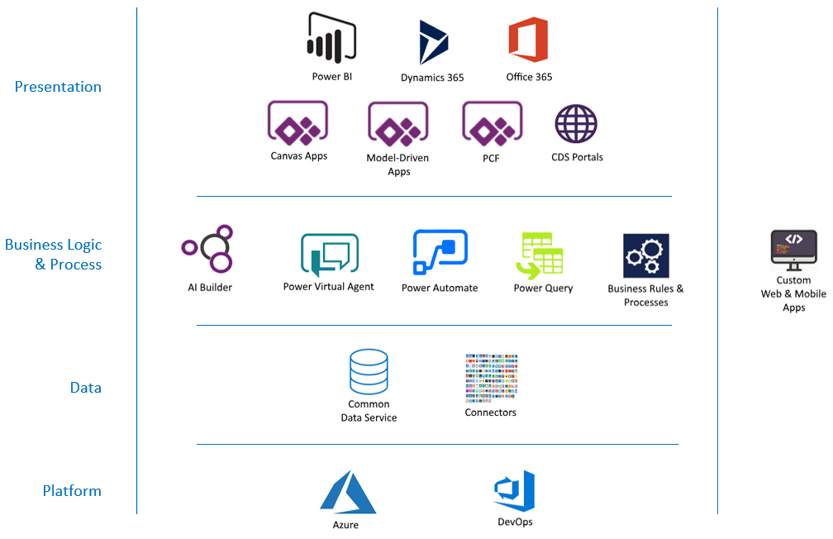
Power Platform Landscape

Slide 5
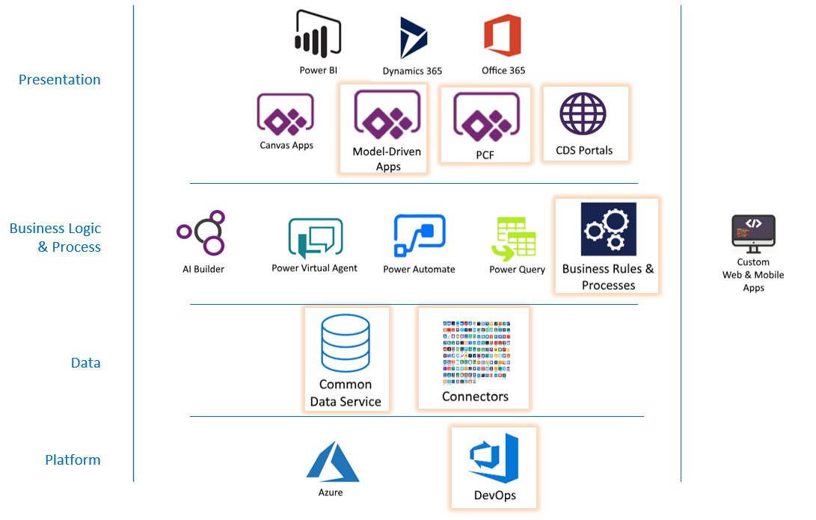
Power Platform Landscape

Slide 6
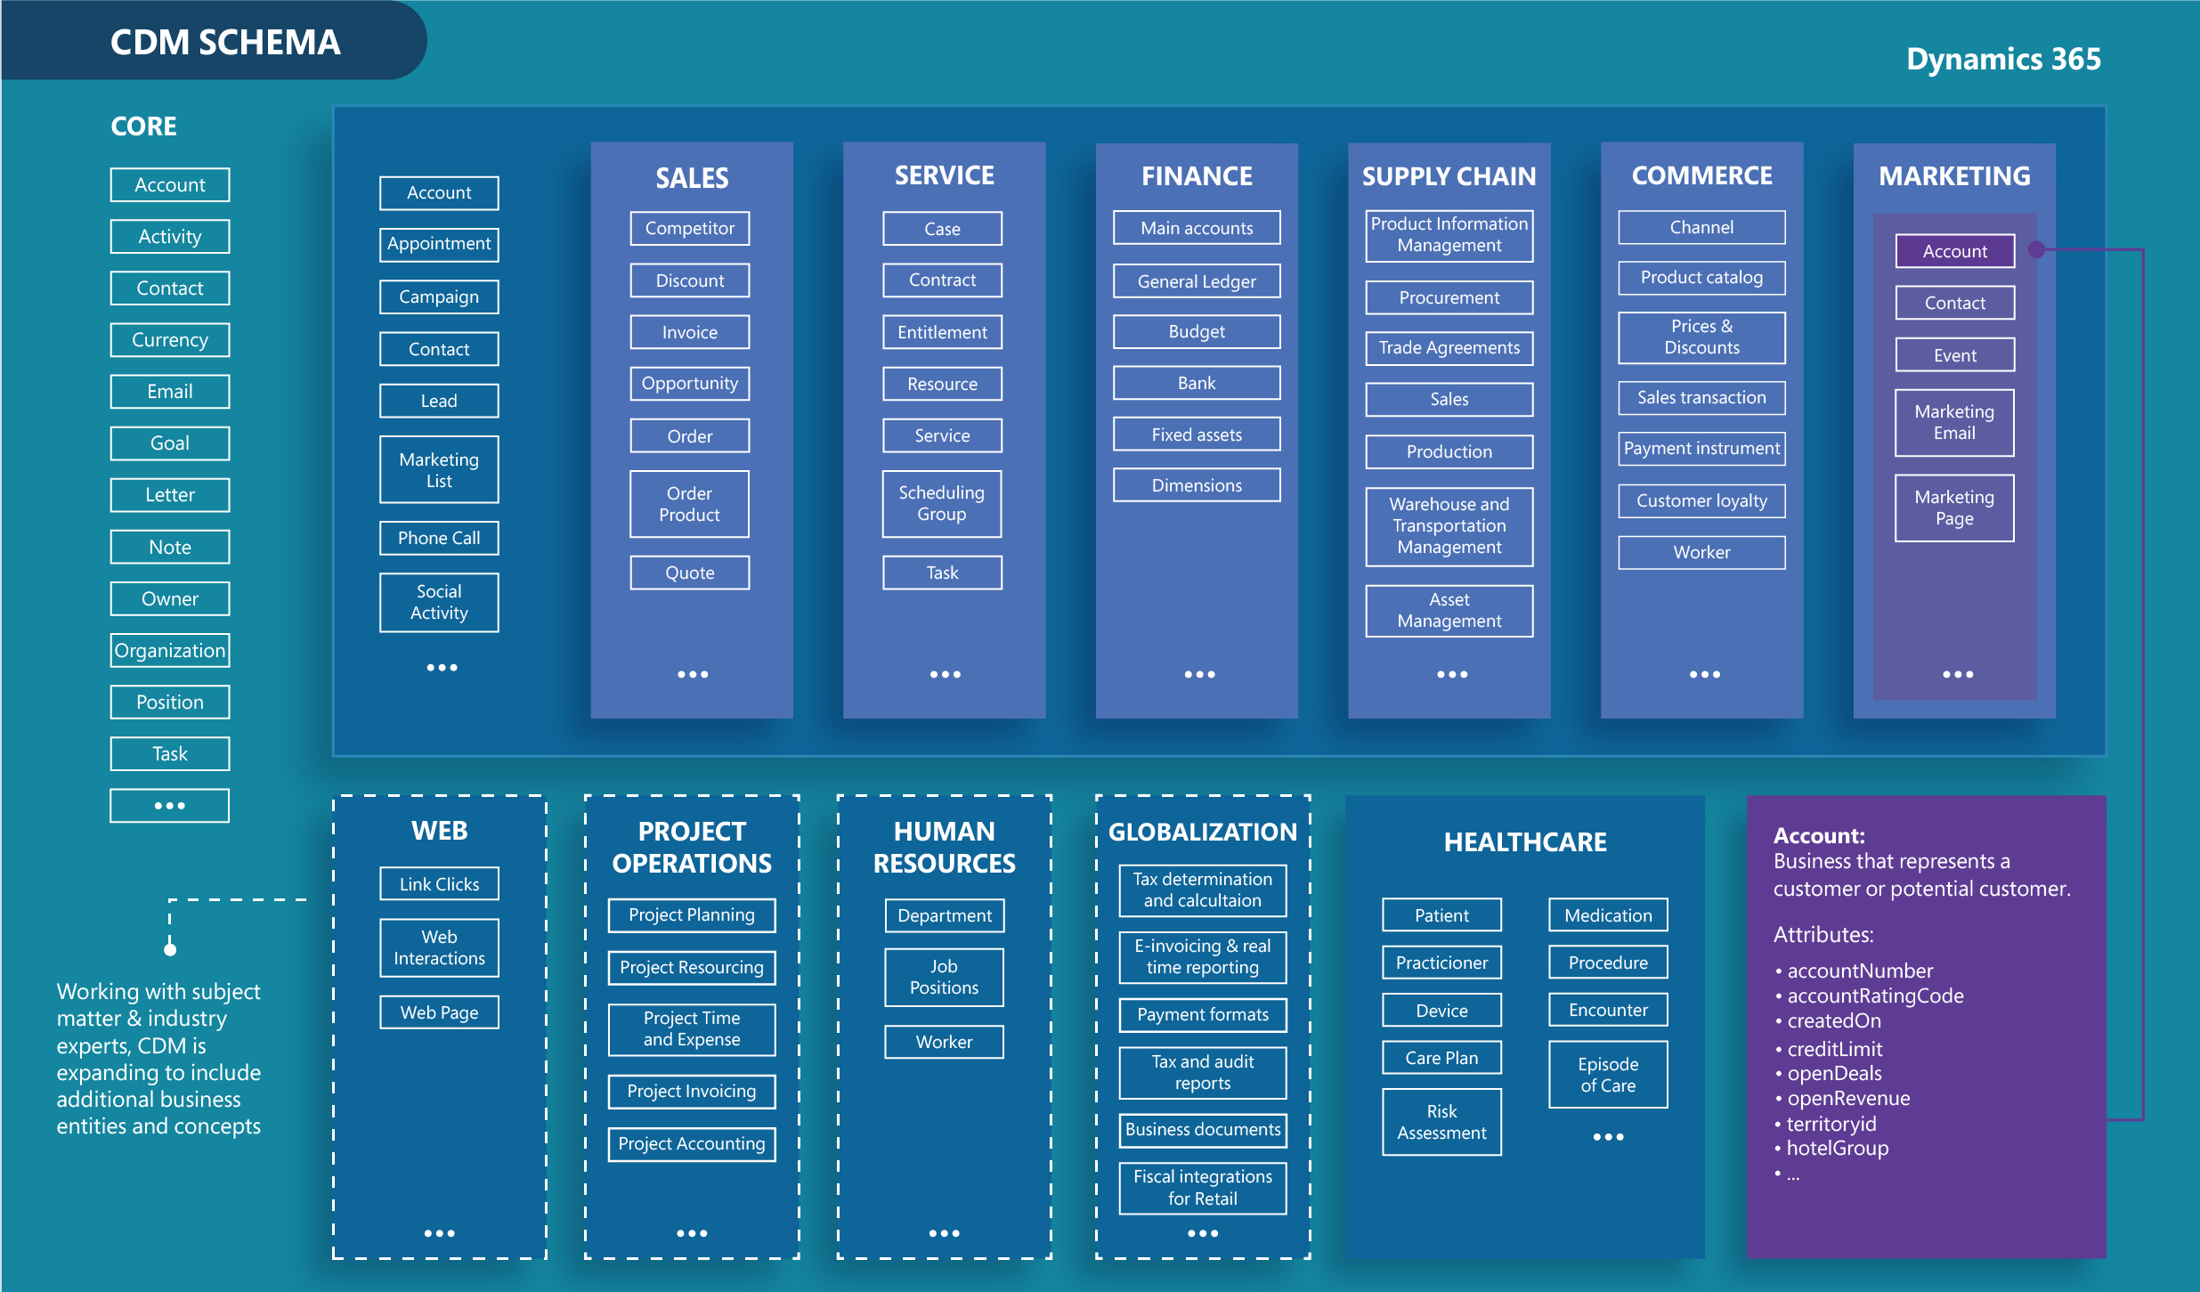
Common Data Model

Slide 7
Dynamics 365 Paradigm
Dynamics 365 Sales
Dynamics 365 Customer Service
Dynamics 365 Field Service
Dynamics 365 Marketing
Dynamics 365 Talent
Forms Pro
…..
1st party apps built on top of CDS

Slide 8
Demo!

Slide 9
Dataflows Overview
What we just saw:
Unify your enterprise systems with no code
Reused existing data model and leverage CDS capabilities
Schedule runs or on demand
Export to Data Lake (Azure Data Lake Gen2)

Slide 10
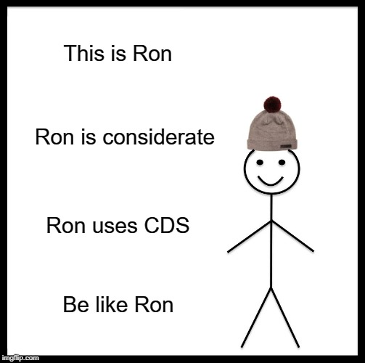
Conclusion and Questions?
More info:
https://docs.microsoft.com/en-us/powerapps/maker/common-data-service/data-platform-intro
https://docs.microsoft.com/en-us/powerapps/maker/common-data-service/self-service-data-prep-with-dataflows

Slide 11

Thank you

